Slide 1
Circulatory System
Year 11 Human Biology
ATAR
PowerPoint 10

Slide 2
SCSA Syllabus Reference
the transport of materials within the internal environment for exchange with cells is facilitated by the structure and function of the circulatory system at the cell, tissue and organ levels
the components of blood facilitate the transport of different materials around the body (plasma and erythrocytes), play a role in the clotting of blood (platelets) and the protection of the body (leucocytes)
blood transfusions rely on determining blood groups and can be used to treat many different diseases and conditions
the lymphatic system functions to return tissue fluid to the circulatory system and to assist in protecting the body from disease
lifestyle choices, including being active or sedentary, the use of drugs and type of diet, can compromise body functioning in the short term and may have long-term consequences
treatment of conditions due to system or organ dysfunction has changed through improvements in early diagnosis and appropriate use of drugs, physical therapy, radiation therapy, and removal and/or replacement of affected parts

Slide 3
Lesson Intention
To explore the structure and function of the circulatory system
To explain the process of blood clotting
To describe how blood moves through the body
To describe the different features of the valves of the heart
To describe the different structure and function of the three blood vessels
To describe the movement of blood through the circulatory system
To explore blood group systems.
To explore the function and structure of the lymphatic system
To research the effect of lifestyle choices on the circulatory system.

Slide 4
Success Criteria
identify and describe the structure of blood
describe how oxygen and carbon dioxide are transported through blood
describe how nutrients and waste are transported
explain the process of blood clotting
describe how blood moves through the body (overall process, from body → heart→ lungs and then back to heart)
summarise the features of the valves of the heart (Pg. 111 Table 5.2)
describe the structure and function of blood vessels (arteries, capillaries and veins)
distinguish between arteries, capillaries and veins
distinguish between vasodilation and vasoconstriction

Slide 5
Success Criteria
describe the sequence of events of the cardiac cycle
describe the structure of the heart and the circulation of blood
calculate cardiac output
distinguish between the ABO blood group system and the Rh blood group system.
distinguish between antigens and antibodies
recognise that is blood mixing is incompatible then the erythrocytes clump together (agglutinate).
summarise the different types of transfusions (whole blood, red cell concentrates, platelets concentrates, cryoprecipitate, immunoglobulins, autologous transfusion)

Slide 6
Success Criteria
describe the function of the lymphatic system
recall the structure of the lymphatic system
explain the role of the lymphatic system in defence against disease
independently research using devices provided
take concise notes
summarise their information in a short presentation to the class

Slide 7
Vocabulary
Formed elements: any cell or cell-like structure in the blood.
Plasma: the fluid part of the blood in which cells are suspended.
Erythrocytes: one of the formed elements of the blood; contains haemoglobin
Leucocytes: one of the blood cells; it contains a nucleus, but no haemoglobin

Slide 8
Vocabulary
Thrombocytes: one of the formed elements of blood; a fragment of cytoplasm enclosed in a membrane but lacking a nucleus
Haemoglobin: the pigment in red blood cell; it is involved in the transport of oxygen and some carbon dioxide through the body
Oxyhaemoglobin: oxygen combined with haemoglobin
Carbaminohaemoglobin: a molecule resulting from a combination of carbon dioxide and haemoglobin

Slide 9
Vocabulary
Metabolic waste: substances produced by cells that cannot be used and that would be harmful if allowed to accumulate
Coagulation: the process of blood becoming gel-like; also called clotting
Thrombus: blood cells, platelets and plasma trapped together in a mesh of fibrin
Clot retraction: contraction of the fibrous threads of a blood clot

Slide 10
Vocabulary
Heart: a hollow, muscular organ that pumps blood
Sternum: the breast bone
Pericardium: membrane enclosing the heart
Septum: the partition between the left and right sides of the heart
Cardiac muscle: the muscle that forms the wall of the heart

Slide 11
Vocabulary
Atrioventricular valve: valves within the heart that ensure the blood flows through it in one direction only.
Semilunar valve: valve preventing blood from flowing back into the ventricles; located at the start of the aorta and pulmonary artery.
Arteries: a blood vessel that carries blood away from the heart
Vasoconstriction: decrease in the diameter of blood vessels, restricting the flow of blood

Slide 12
Vocabulary
Vasodilation: increase in the diameter of blood vessels, increasing the flow of blood
Capillaries: a microscopic blood vessel that links arterioles and venules
Veins: a blood vessel that carries blood towards the heart
Cardiac Cycle: the cycle of events that occurs in one complete heartbeat
Systole: the period when the heart muscle contracts

Slide 13
Vocabulary
Diastole: the period of relaxation of the heart (between contractions), during which it fills with blood.
Blood transfusion: the transfer of blood, or of some of the components of blood, into the circulation of a person.
Antigen: any substance capable of causing the formation of antibodies when introduced into the tissue.
Antibody: a substance produced in response to a specific antigen; it combines with the antigen to neutralise or destroy it

Slide 14
Vocabulary
Agglutination: the clumping together of micro-organisms or of blood cells.
Lymph: colourless fluid that circulates through the lymphatic vessels before returning to the blood.
Lymphatic system: a system of vessels that drains excess fluid from the tissues.
Lymph vessels: a large vessel that collects lymph from the lymph capillaries. Lymphatic vessels join up and eventually return lymph to the blood.

Slide 15
Vocabulary
Lymph nodes: an oval or bean-shaped structure found on the lymphatic vessels; it is involved in protection against infection. Also called a lymph gland.
Lymphocytes: a type of white blood cell; also found in lymph nodes and in lymph.
Phagocytic cells: cells that can engulf and digest micro-organisms and cell debris.

Slide 16
The functions of blood
Functions include
transporting oxygen and nutrients to the cells of the body
transporting carbon dioxide and other waste products away from the cells
transporting chemical messengers called hormones to the cells
maintaining the pH of body fluids
distributing heat and maintaining body temperature
maintaining water content and ion concentration of body fluids
protecting against disease-causing micro-organisms
clotting when vessels are damaged, thus preventing blood loss.

Slide 17
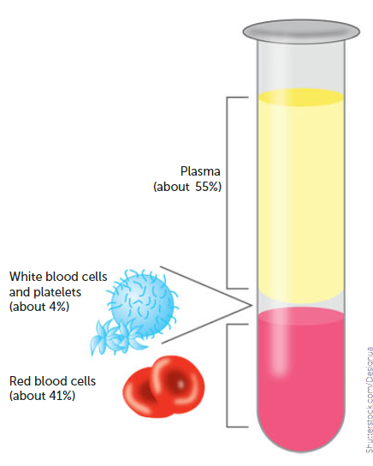
Structure of blood
Blood is composed of plasma and formed elements.
Plasma makes up ~ 55% of blood volume
Formed elements make up ~ 45% of blood volume and consist of red blood cells, white blood cells and platelets.

Slide 18
Plasma
Mixture of water with dissolved substances such as sugar and salts
The function of plasma is to transport the components of blood, including cells, nutrients, wastes, hormones, proteins and antibodies, throughout the body.

Slide 19
Erythrocytes
AKA- Red blood cells
Account for 40-45% of bloods volume
Cells are a biconcave shape- flattened in the middle on both sides. Red blood cells do not contain a nucleus.
Their function is to transport oxygen from the lungs to the cells throughout the body.

Slide 20
Leucocytes
AKA white blood cells
Play an important role in protecting the body from infection.
Larger than red blood cells, but only make up ~1% of blood.

Slide 21
Different types of Leucocytes
Name | Description
Neutrophils | Most common, contain enzymes to digest pathogens
Monocytes | Form other cells e.g. macrophages (immune system)
Lymphocytes | Involved in immune response
Basophils | Responsible for allergic reactions
Eosinophils | Lead to inflammatory response

Slide 22
Thrombocytes
AKA Platelets
Small fragments of cells.
When a blood vessel is injured, the platelets adhere to the lining and form a scaffold for the coagulation of the blood to form a clot.

Slide 23
Transport of Oxygen
Oxygen is not very soluble in water, so only ~3% of oxygen is carried in solution in the blood plasma. The other ~97% is carried in combination with haemoglobin molecules, which are found only in red blood cells.
Haemoglobin is able to combine with oxygen to form a compound called oxyhaemoglobin. Oxygen combines with haemoglobin when the oxygen concentration is relatively high. This occurs in the capillaries in the lungs.

Slide 24
Transport of Oxygen
Oxyhaemoglobin breaks down to haemoglobin and oxygen when the concentration of oxygen is relatively low. Oxyhaemoglobin is bright red in colour. Haemoglobin is a dark red/purplish colour.
Red blood cells are well suited to their function of oxygen transport because they contain haemoglobin, have no nucleus, are shaped like biconcave discs (SA).
The majority of oxygen is transported on erythrocytes as oxyhaemoglobin.

Slide 25
Transport of Carbon Dioxide
~7-8% is dissolved in the plasma and carried in solution.
~22% combines with the globin part of the haemoglobin molecule to form a compound called carbaminohaemoglobin.
~70% is carried in the plasma as bicarbonate ions (HCO₃⁻)
As blood flows through the capillaries between body cells, carbon dioxide diffuses into the plasma due to the difference in carbon dioxide concentration.

Slide 26
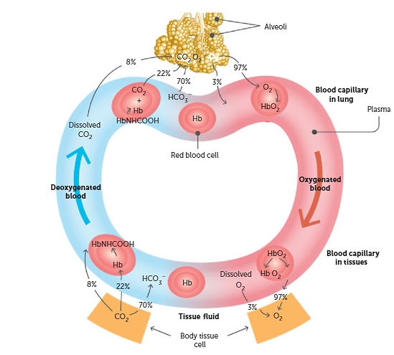

Slide 27
Transport of Carbon Dioxide
Some carbon dioxide dissolves in the plasma, some combines with haemoglobin, but most reacts with the water to form carbonic acid (H₂CO₃).
Carbonic acid then ionises into hydrogen ions and bicarbonate ions.

Slide 28
Transport of nutrients and waste
Nutrients and other waste products are dissolved and transported in the blood plasma.
Some of the important ions dissolved in the blood plasma are sodium ions, calcium ions, potassium ions, chloride ions and iodide ions. Organic nutrients dissolved in the blood plasma include glucose, vitamins, amino acids, fatty acids and glycerol.
Metabolic wastes such as urea and uric acid are harmful if they accumulate and are therefore removed.

Slide 29
Blood clotting process
Vasoconstriction: the muscles in the walls of the small arteries that have been injured or broken constrict immediately to reduce blood flow and, therefore, blood loss.
Platelet plug: the internal walls of blood vessels are normally very smooth, but damage can cause platelets to stick. They will build up at the injury site, forming a plug. This reduces bleeding.
Coagulation: for more serious injuries. Clotting factors (present in plasma) and fibrin (protein) form a mesh that traps blood cells, platelets and plasma.

Slide 30
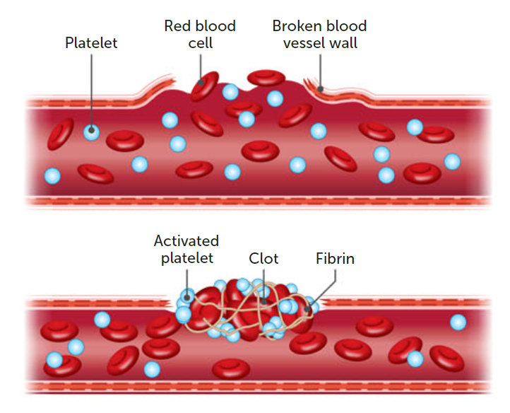

Slide 31
Blood clotting process
4. Clot retraction: the network of threads contractions removing fluid (serum) from the area. The clot then dries, forming a scab over the wound that prevents entry of infecting micro-organisms.

Slide 32
The heart
The pump that pushes blood around the body. Made up of cardiac muscle.
It is enclosed in a membrane called the pericardium. The left and the right sides of the heart are separated by a wall called the septum.

Slide 33
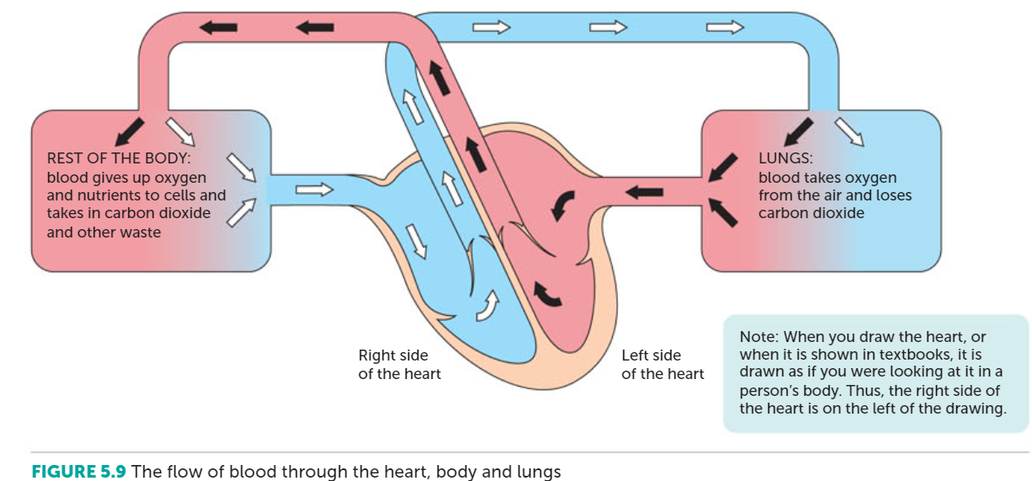

Slide 34
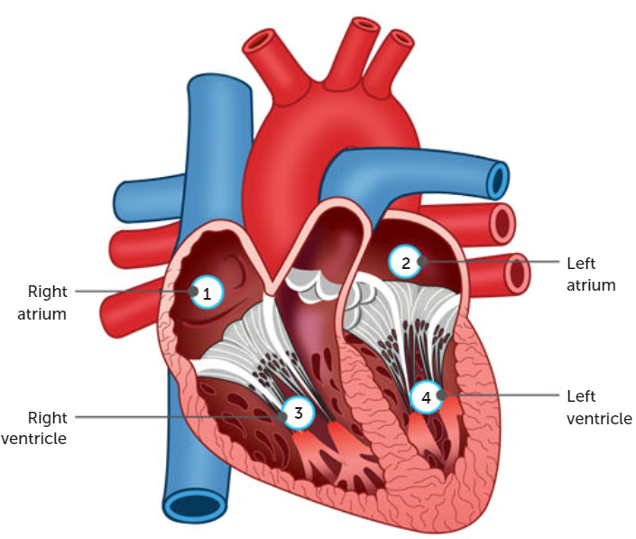
The heart
The heart is divided into four chambers
The right atrium receives blood from the body and passes it to the right ventricle
The right ventricle pumps blood to the lungs
The left atrium receives blood from the lungs and passes it to the left ventricle
The left ventricle pumps blood to the body

Slide 35
Blood vessels- Arteries
Are blood vessels that carry blood away from the heart
The largest artery is the aorta, which takes blood from the left ventricle to the body.
Another important artery is the pulmonary artery, which takes blood from the right ventricle to the lungs.

Slide 36
Blood vessels- Arteries
The walls of an artery contain smooth muscle and elastic fibres. When the ventricles contract and push blood into the arteries, the walls of the arteries stretch to accommodate the extra blood.
When the ventricles relax, the elastic artery walls recoil. The elastic recoil keeps the blood moving and maintains the pressure.

Slide 37
Blood vessels- Arteries
Vasoconstriction: contraction of a blood vessel.
Vasodilation: the muscle relaxes to increase blood flow to an organ.
The very large arteries that receive blood pumped by the ventricles divide into smaller arteries. These in turn divide into very small arteries, known as arterioles. It is the arterioles that supply blood to the capillaries.

Slide 38
Blood vessels- Arteries
Like the larger arteries, the arterioles have smooth muscle in their walls. Contraction or relaxation of this muscle is very important in regulating blood flow through the capillaries.
Waste products (carbon dioxide) act as vasodilators, substances that produce a local widening, or dilation, of arterioles. This results in increased blood flow through the muscle tissues, ensuring that the cells are adequately supplied with oxygen and nutrients for continued functioning.

Slide 39
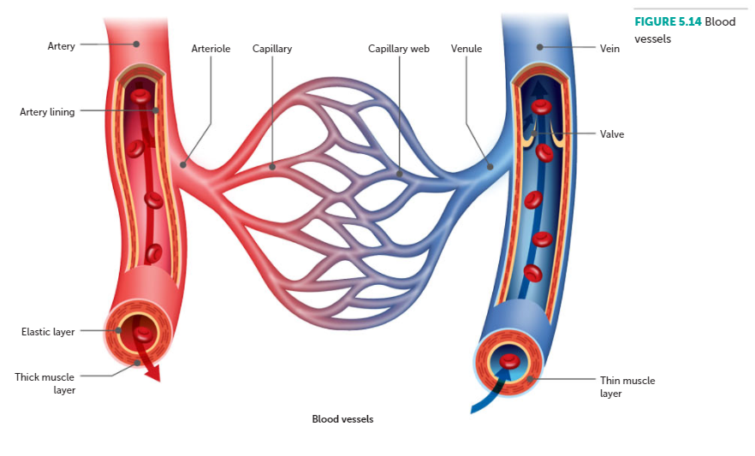

Slide 40
Blood vessels- Capillaries
Link between arteries and veins
Microscopic blood vessels that form a network to carry blood close to nearly every cell in the body
Enables the cells to get their requirements from the blood and to pass their waste into the blood.
Only one layer of cells thick

Slide 41
Blood vessels- Veins
Carry blood towards the heart
Capillaries join into small veins (venules), which then join up to make larger veins. These culminate in the:
Inferior vena cava and superior vena cava- bring blood from the body to the right atrium. Superior vena cava brings blood from above the heart, while inferior vena cava brings blood from below the heart
Pulmonary veins- bring blood from the lungs to the left atrium. There are four pulmonary veins- two from each lung.

Slide 42
Blood vessels- Veins
Veins and venules do not have muscular walls and are not able to change their diameter in the ways arteries do.
Blood pressure in the veins is relatively low because the blood loses most of its pressure as it flows through the tiny capillaries. The walls of veins are therefore much thinner than those of arteries.
Walls are not elastic, but have valves to prevent backwards flow.

Slide 43
Cardiac Cycle
Sequence of events that occurs in one complete beat of the heart.
Systole- the pumping phase of the cardiac cycle, where the muscle contracts
Diastole- the filling phase where the heart muscle relaxes

Slide 44
In your own time…
Page 117
Really good diagram of the heart
You need to learn it, so learn it in your own time, in your own way

Slide 45
Cardiac Output
How quickly the blood flows around the body depends on how fast the heart is beating and how much blood the heart pumps with each beat.
Cardiac output (mL/minute) = stroke volume (mL) x heart rate (beats/minute)

Slide 46
Blood groups- Introduction
Two systems- ABO blood group system and Rh blood group system
There are more. Don’t worry about them this year
Surface of red blood cells is coated with sugar and protein molecules that are able to stimulate the immune system. These molecules are called antigens and the proteins produced by the immune system is called an antibody. The antigen and its antibody combine to form a complex and cause a reaction.

Slide 47
ABO Blood groups
There are two sugar antigens involved in the ABO classification of blood groups: antigen A and antigen B.
On the surface of the red blood cells, a person may have either antigen A, antigen B, both antigens or neither. The four possibilities correspond to the four groups of the ABO system; group A (antigen A), group B (antigen B), group AB (both antigens) and group O (neither antigen).

Slide 48
Antibodies
The antibody that reacts against antigen A is called anti-A, while anti-B reacts against antigen B.
A person’s immune system is able to recognise their own antigens and will not produce antibodies for them. However, they will produce antibodies for antigens that are non-self.

Slide 49
Rh blood groups
Like the ABO blood system, it is based on antigens that occur on the surface of the red blood cells. Unlike the ABO antigens, which are sugars, the Rh antigens are proteins.
A person with Rh antigens is said to be Rh positive. A person without these antigens is Rh negative. An individual without the Rh antigens is able to produce an anti-Rh antibody that reacts against those antigens. Rh-positive individuals cannot produce an anti-Rh antibody.

Slide 50
Transfusions
A transfusion transfers blood, or one of the components of blood, from one person to another. The blood groups of the donor and the recipient need to match
The mixing of blood types that are incompatible can cause the erythrocytes to clump together, or agglutinate.
If the receiver’s blood contains, or is able to make, antibodies against the antigens on the donor’s red cells, the foreign cells will clump together and disintegrate.

Slide 51
Transfusions
Rh blood groups are also matched for transfusion purposes. The anti-Rh antibody is not normally present in the plasma of Rh-negative people, but it is produced on exposure to the Rh antigen.
The first transfusion of Rh- positive blood to an Rh-negative patient does not usually cause problems because the antibodies are produced slowly the first time. Subsequent exposures result in rapid production of antibodies.

Slide 52
Types of transfusions
Whole blood- is blood take from the donor but with a chemical added to prevent clotting. E.g. used in cases of severe blood loss.
Red cell concentrates- most widely used component of blood. They are produced by spinning blood at very high speeds in a centrifuge. Plasma goes to the top. Transfusions of red cell concentrates are used for patients suffering from heart disease or severe anaemia.

Slide 53
Types of transfusions
Platelet concentrates are given to patients with abnormal platelets or a reduced number of platelets.
Cryoprecipitate is obtained by freezing the plasma and thawing it slowly. Used to treat some forms of haemophilia, but it is most often used for severe bleeding.
Immunoglobulin are a group of proteins that act as antibodies. They are extracted from the blood and used for patients who are deficient in antibodies.

Slide 54
Types of transfusions
Autologous transfusion is when the patient’s own blood is used. The blood is collected from the patient prior to an operation.
Used for mostly elective surgery
Eliminate the risk for transmission of disease and possible side effects

Slide 55
Summary of the ABO blood groups
Blood Group | Antigens on red blood cells | Antibodies in plasma | Able to donate to people with blood group … | Able to receive blood (red cell concentrate) from people with blood group…
A | Antigen A | Anti-B | A, AB | A, O
B | Antigen B | Anti-A | B, AB | B,O
AB | Antigen A and Antigen B | Neither anti-A nor anti-B | AB | A, B, AB, O
O | Neither antigen A nor antigen B | Both anti-A and anti-B | A, B, AB, O | O

Slide 56
The Lymphatic System
As blood enters the capillaries, the relatively high pressure forces some of the fluid in the blood through the capillary walls into the tissues.
The main function of the lymphatic system is to collect some of the fluid that escapes from the blood capillaries and return it to the circulatory system. The lymphatic system is also an important part of the body’s internal defence against disease-causing organisms.

Slide 57
Structure of the lymphatic system
Consists of
a network of lymph capillaries joined to larger lymph vessels
lymph nodes, which are located along the length of some lymph vessels.

Slide 58
Lymph vessels
Fluid tends to leak out at the atrial end of a blood capillary due to the high pressure in the vessel.
Some fluid returns to the capillary at the venous end. The excess fluid in the tissues is returned to the blood by the lymphatic system and is called lymph.
Lymph does not circulate. It is a one-way system carrying fluid away from the tissues.

Slide 59
Lymph vessels
The lymph vessels originate as blind-ended tubes in the spaces between the cells of most tissues.
Lymph capillaries are usually slightly larger than blood capillaries. They are also more permeable than most blood capillaries. Proteins and disease-causing organisms in the intercellular fluid can easily pass through the wall of the lymph capillaries into the lymph.
The network of lymph vessels joins to form two lymphatic ducts that empty the lymph into large veins in the upper chest.

Slide 60
Lymph
Lymph is moved through the lymphatic vessels as a result of smooth muscle, skeletal muscle and valves.
The smooth muscle layer of the vessels is able to contact to push the lymph along the vessel. The skeletal muscles surrounding the vessels are also able to contact, providing additional force.
As there is no central pump, there is no force driving the direction of the flow of lymph. Therefore, larger lymph vessels have valves that close when the pressure drops.

Slide 61
Lymph nodes
Occur at intervals along the lymphatic vessels. They are most numerous around the neck, armpits, groin and around the alimentary canal.
Each node is surrounded by a capsule of connective tissue that extends into the node, forming a framework. Within the framework are masses of lymphoid tissue, containing cells known as lymphocytes, macrophages and plasma cells. The lymph passes through several nodes before entering the circulatory system.

Slide 62
Lymphatic system and disease
Lymph entering the lymph nodes contains cell debris, foreign particles and micro-organisms that have penetrated the body’s external defence. Some are able to cause disease, and therefore must be destroyed.
Large particles, such as bacteria, are trapped in the meshwork of fibres as the lymph flows through the spaces in the nodes. Macrophages destroy these particles via phagocytosis.

Slide 63
Lymphatic system and disease
When infection occurs, the formation of lymphocytes increases, causing the lymph nodes to become swollen and sore. E.g. an infected finger may result in swelling and tenderness in the armpit, where there are a large number of lymph nodes.

Slide 64
Recall Knowledge
Explain how oxygen is transported from the alveoli to the body cells
Draw a flow chart to show the steps involved in blood clotting
List the functions of the lymphatic system

Slide 65
Apply Knowledge
Doctors will check the size of lymph nodes in sick patients. Explain why this is an important part of the physical examination.
Compare and contrast lymph vessels and blood vessels.

Slide 66
Homework
Write a summary regarding the different valves in the heart (pg. 111 in your textbook)
When blood plasma is given in a transfusion, would the donor of the plasma have to be the same ABO blood group as the receiver? Explain your answer.

Slide 67
Reading
Pages 102 - 126: Circulatory System Chapter

